Slide 1


Slide 2









Notes:
Internet and Education

Slide 3
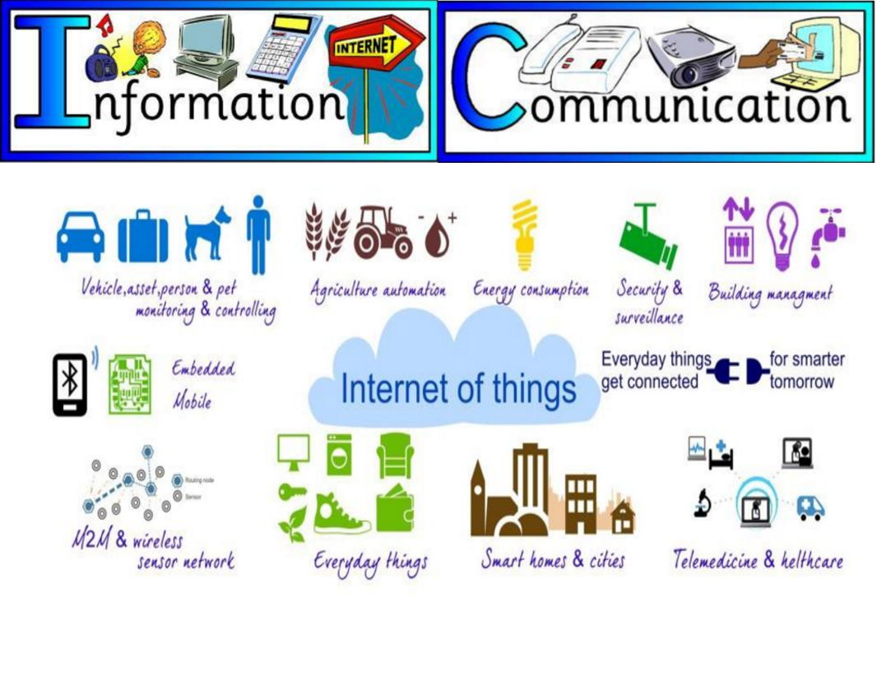
Notes:
Internet and Communication - IOT

Slide 4
E-World
The major areas that we would be discussing today are
E-Governance
E-Commerce
E-Banking

Slide 5
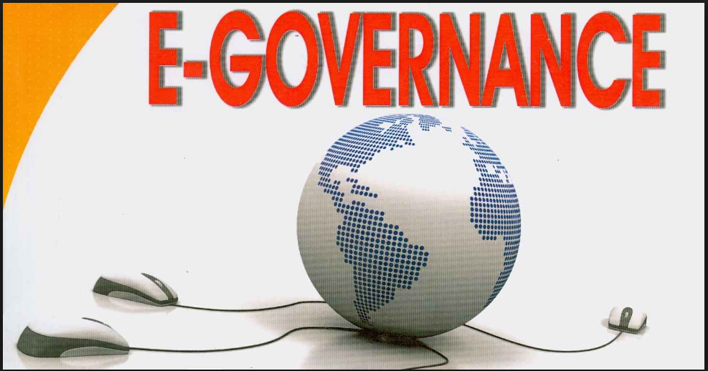

Slide 6
E-Governance
E-Governance Services include
Getting Government Certificates
Aadhaar Card Registration and Download
Voter ID card Registration
Passport Registration
Akshaya Centers

Slide 7
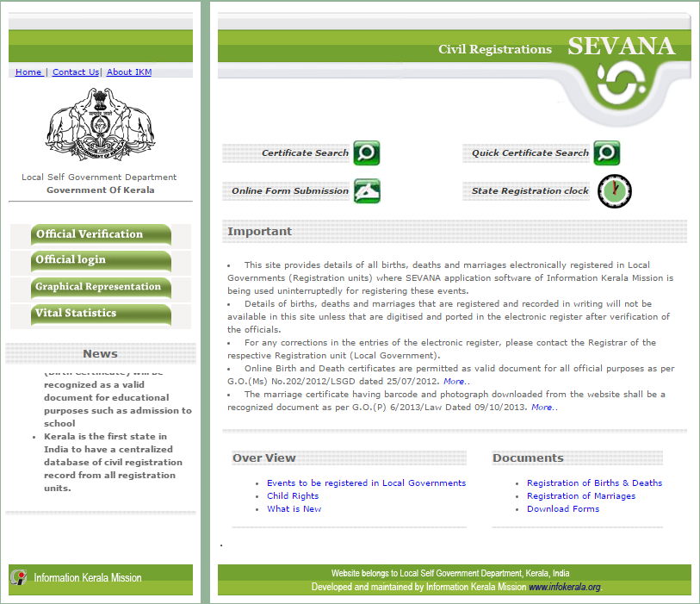
Getting Government Certificates
Birth/Death/Marriage Registrations and Certificate Download - http://cr.lsgkerala.gov.in/

Slide 8
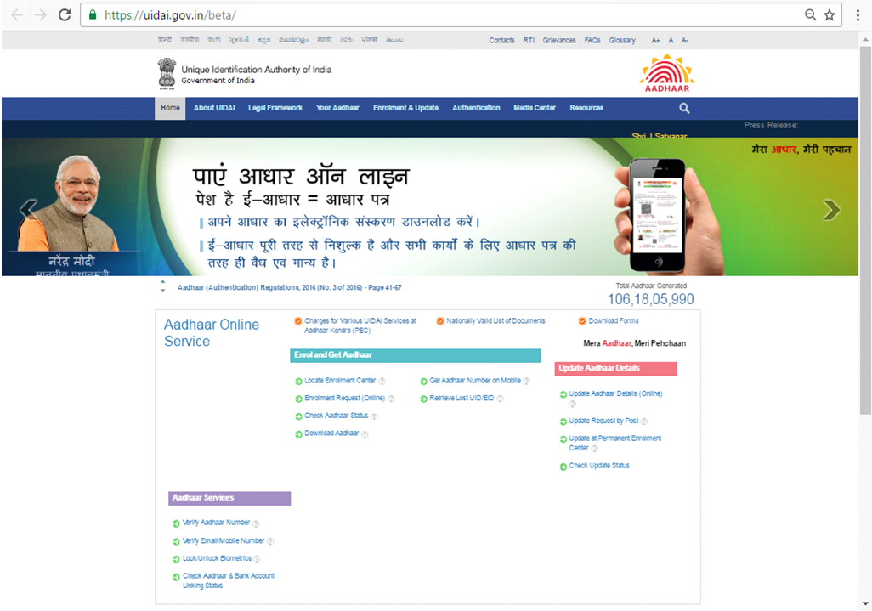
Online Aadhaar Registration
https://uidai.gov.in/beta/

Slide 9
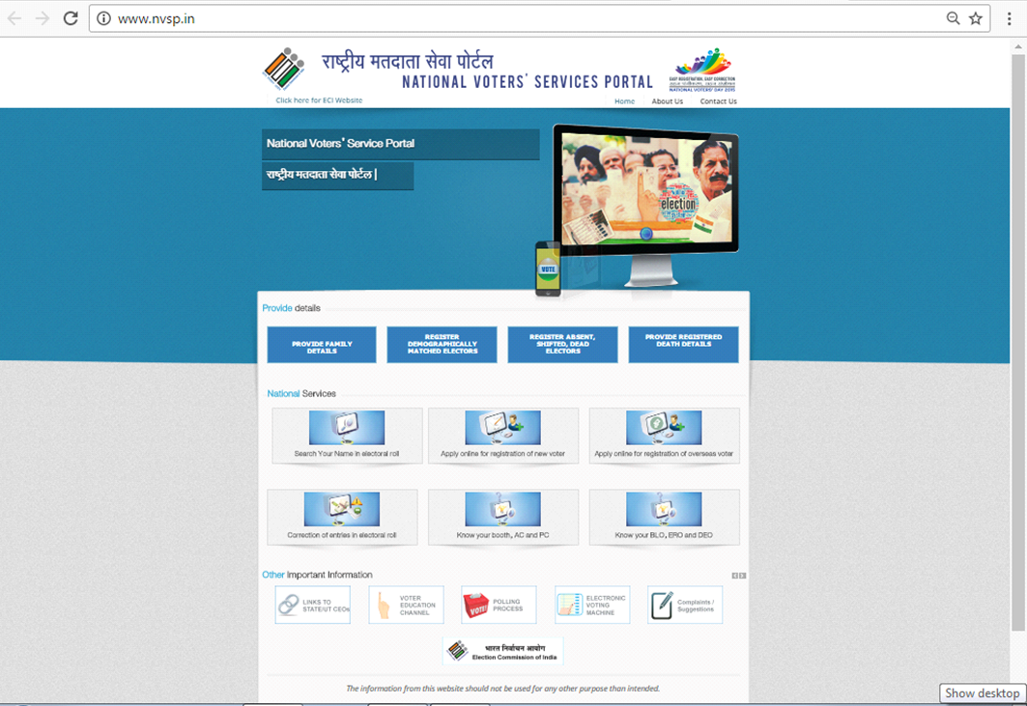
Online Voter Id Registration
http://www.nvsp.in/

Slide 10
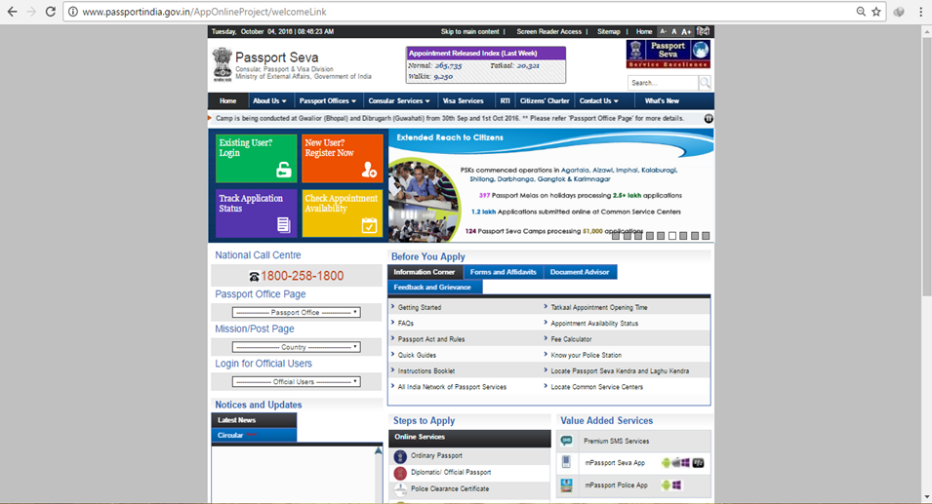
Online Passport Registration
http://www.passportindia.gov.in/AppOnlineProject/welcomeLink

Slide 11
Other Online Applications Include
IRCTC Railway/KURTC Bus Ticket Booking
Electricity Bill Payment
Kerala Authority Water Bill Payment
Booking Bharat/Indane Gas
BSNL Landline/Mobile Bill payment and recharge
MG University Course Registration
Cee Kerala/Kerala Results
Online PSC Registration
Kerala E-District/HSCAP/DCE Scholarship

Slide 12

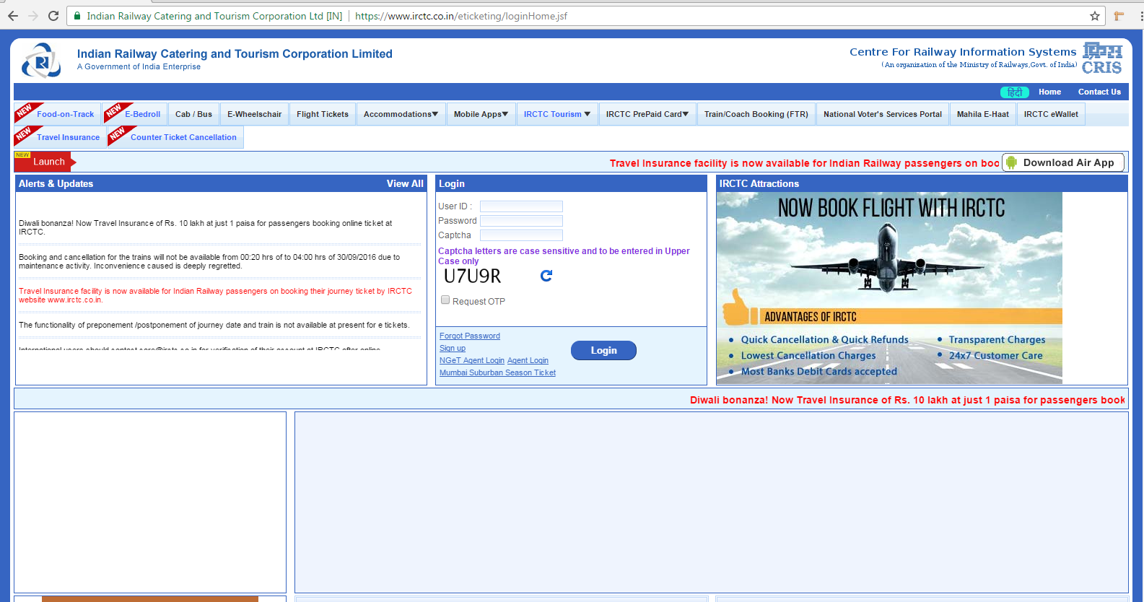
Booking Railway Tickets
https://www.irctc.co.in

Slide 13
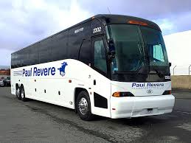
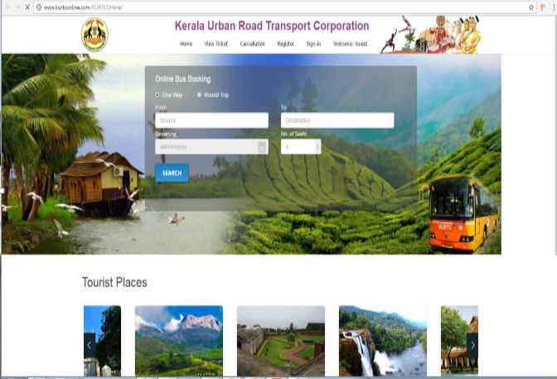
Booking Bus Tickets
www. kurtconline.com

Slide 14
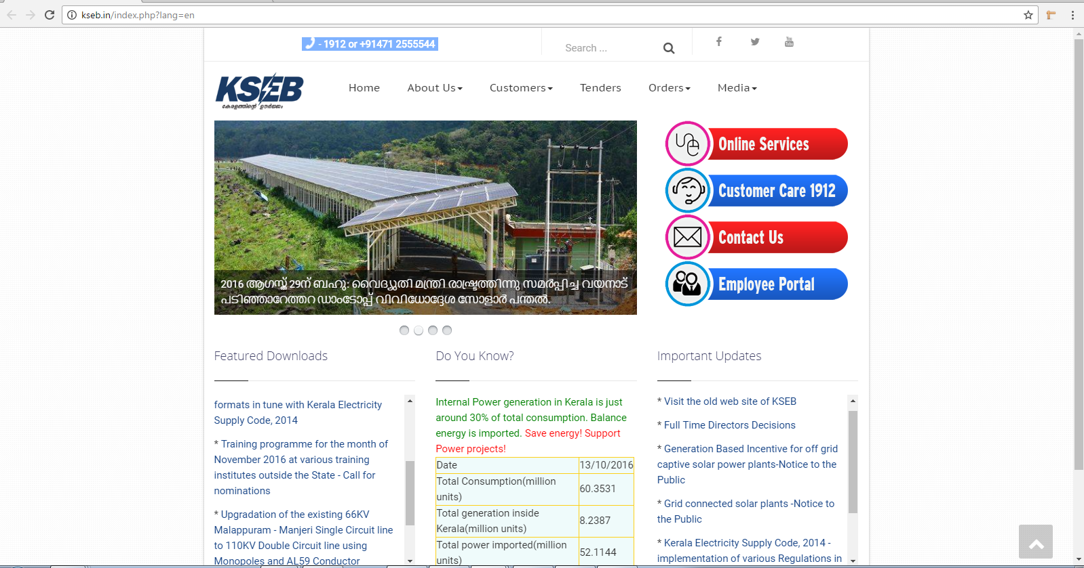
Electricity Bill Payment
http://kseb.in

Slide 15
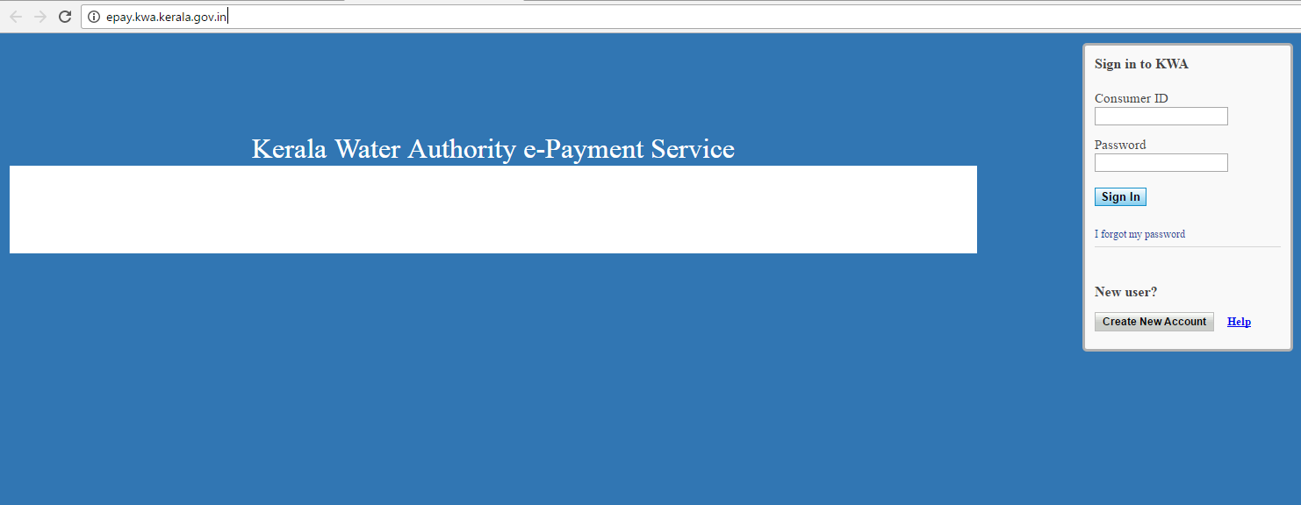
Kerala Authority Water Bill Payment
http://epay.kwa.kerala.gov.in/

Slide 16
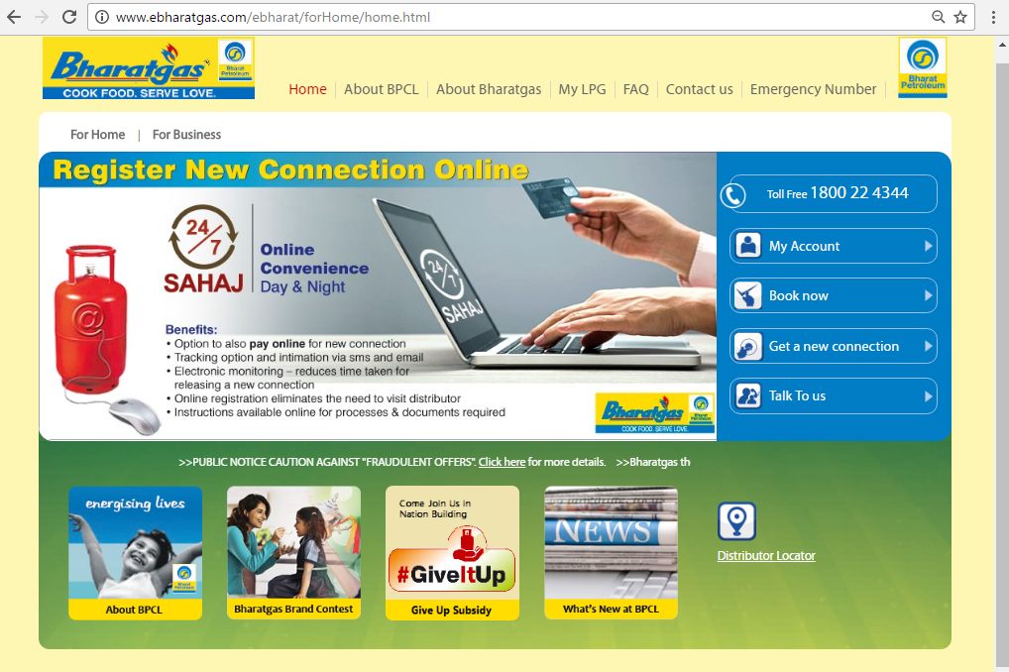
Booking Bharat Gas
www.ebharatgas.com

Slide 17
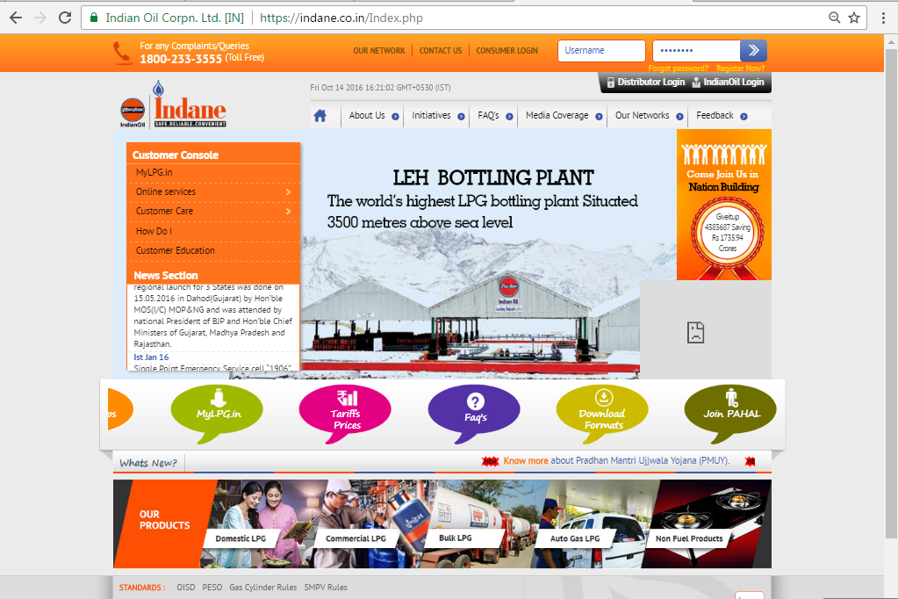
Booking Indane Gas
www.indane.co.in

Slide 18
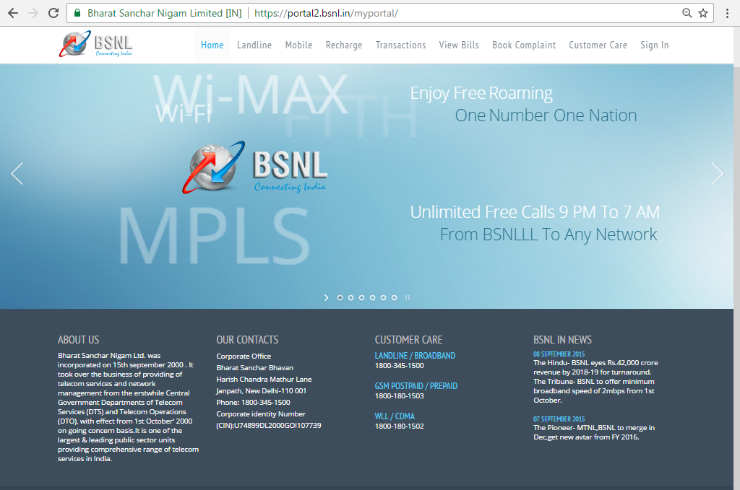
BSNL Online Bill Payment And Recharge
http:// portal.bsnl.in

Slide 19
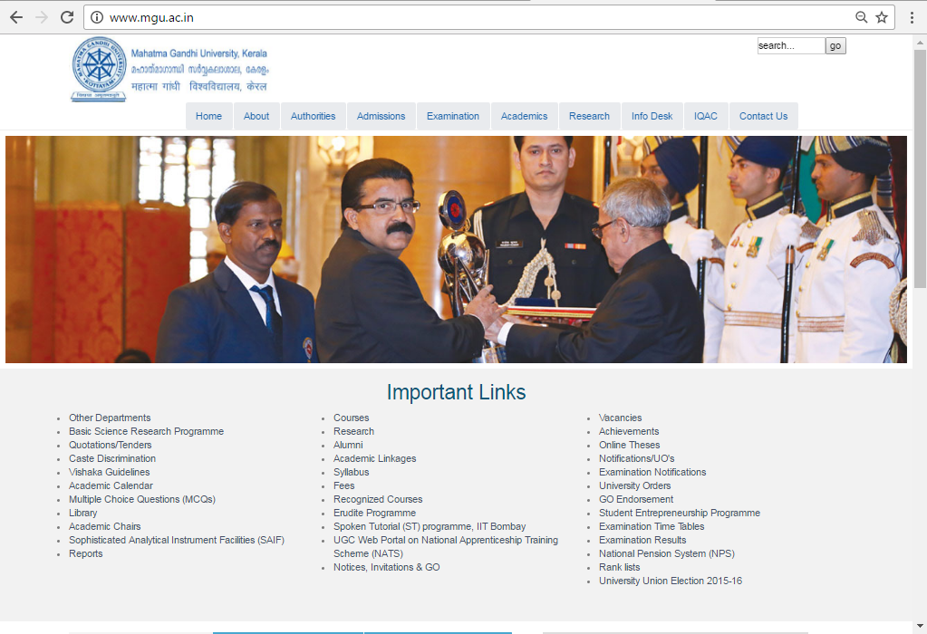
MG University
www.mgu.ac.in

Slide 20
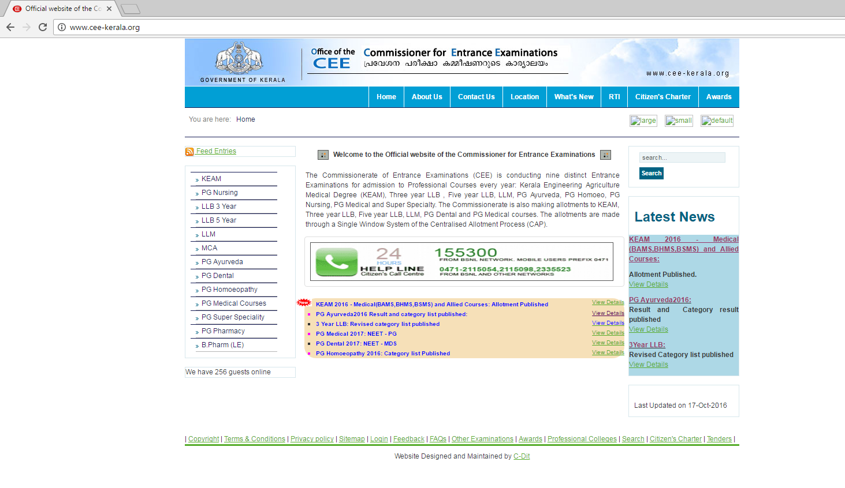
Cee Kerala
http:// cee-kerala.org

Slide 21
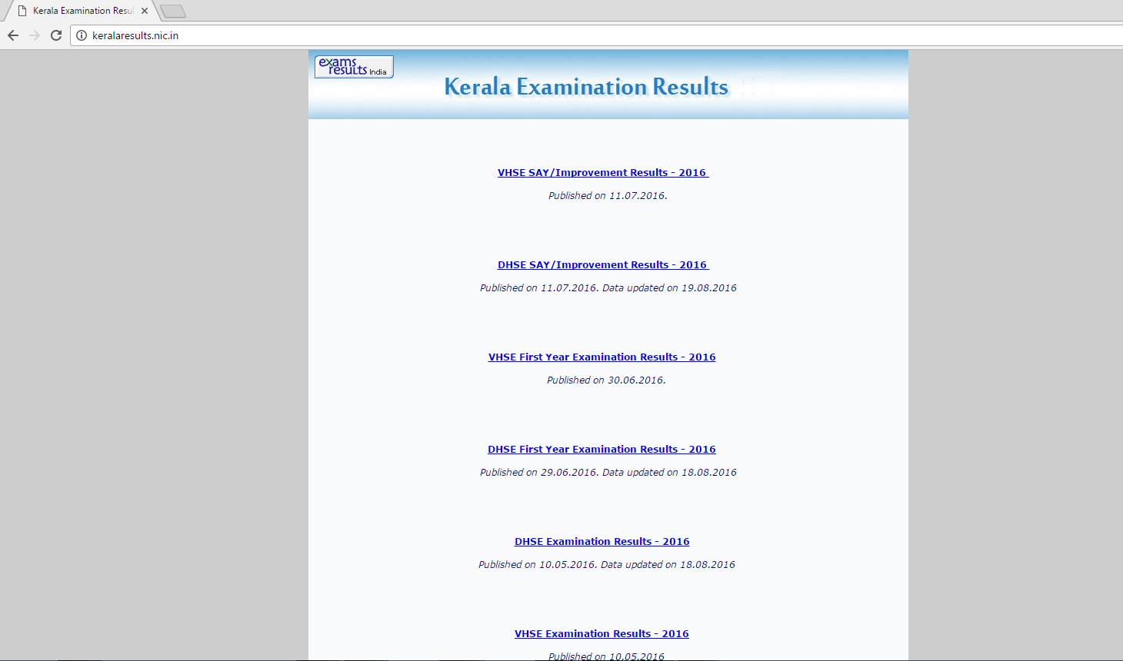
Kerala Results
http://keralaresults.nic.in

Slide 22
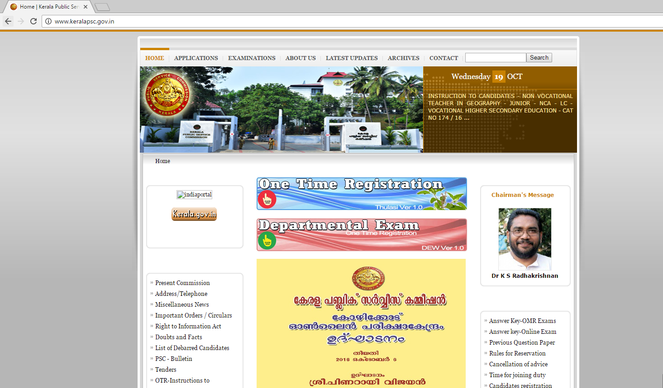
Online PSC Registration
www.keralapsc.gov.in

Slide 23
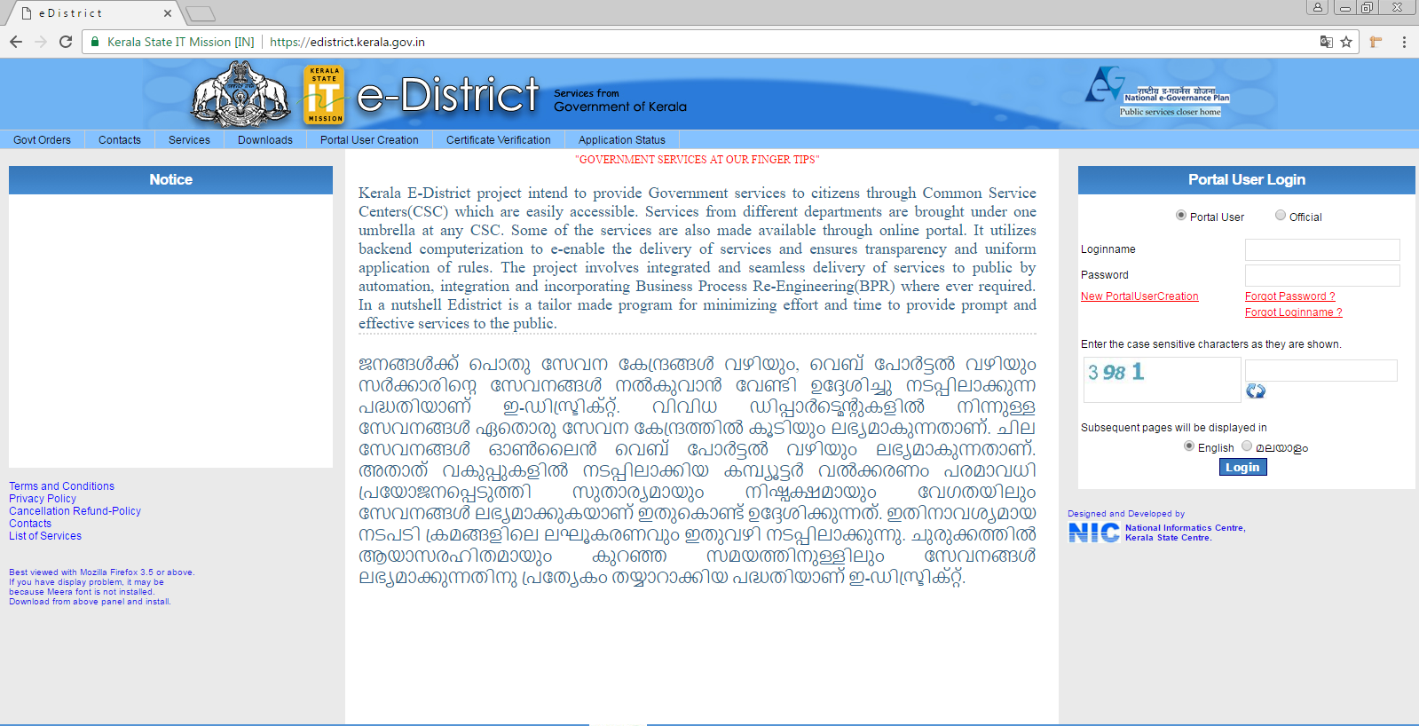
Kerala E-District
http://edistrict.kerala.gov.in

Slide 24
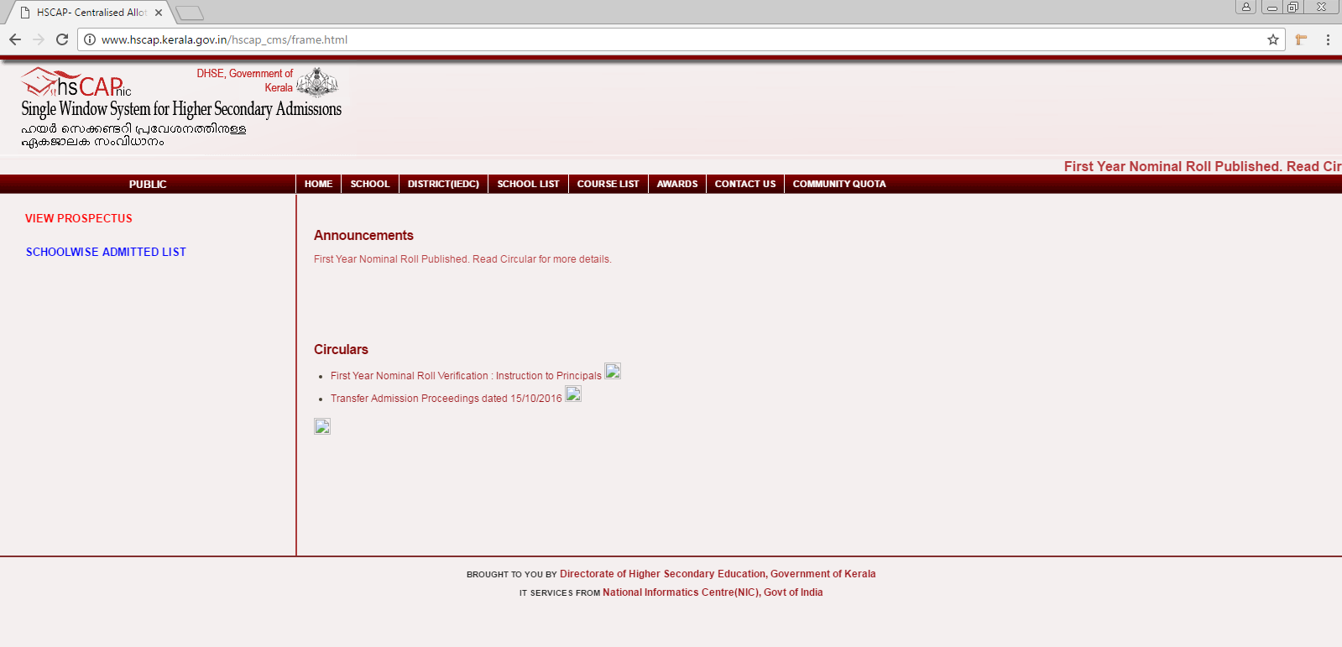
HSCAP
www.hscap.kerala.gov.in

Slide 25
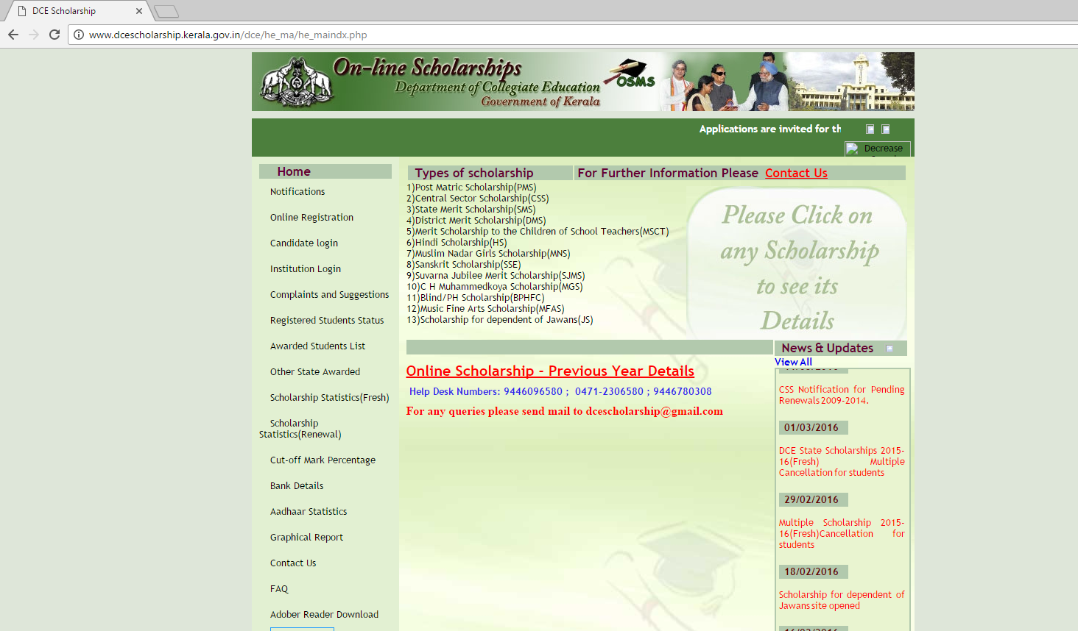
DCE Scholarship
www.dcescholarship.kerala.gov.in

Slide 26
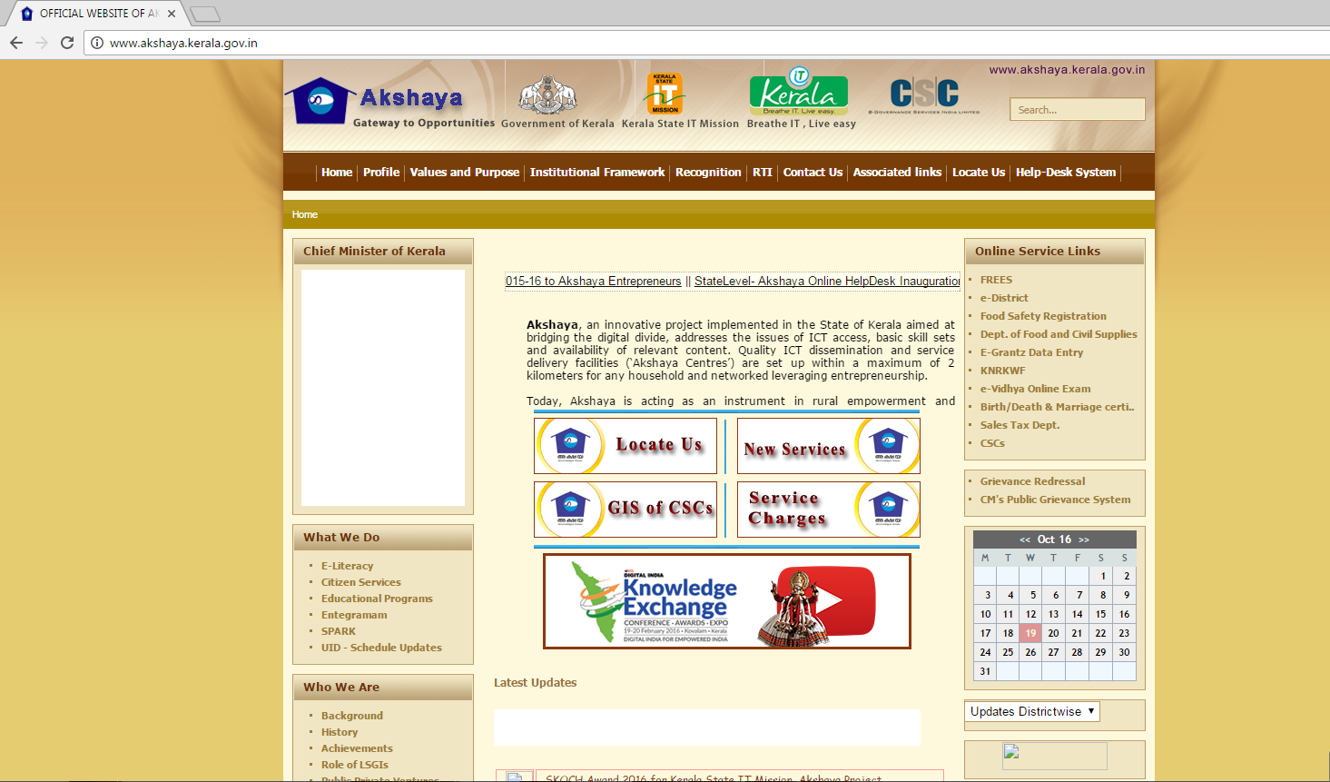
Akshaya Center
http://www.akshaya.kerala.gov.in/

Slide 27
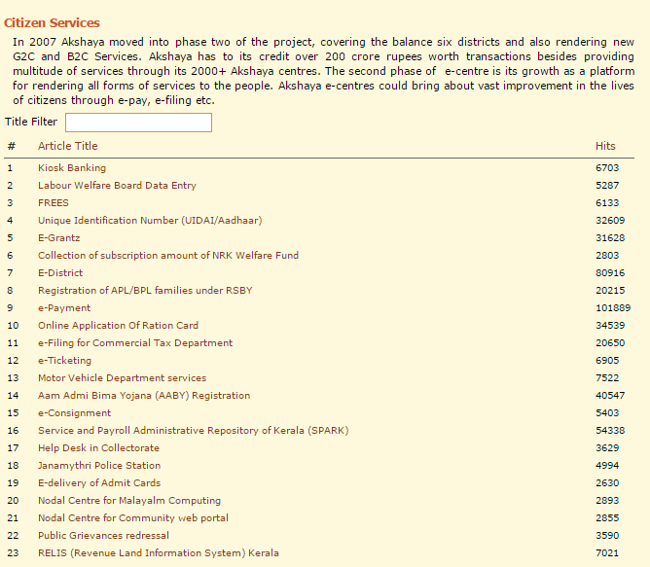
Services that a citizen gets from an Akshaya center

Slide 28
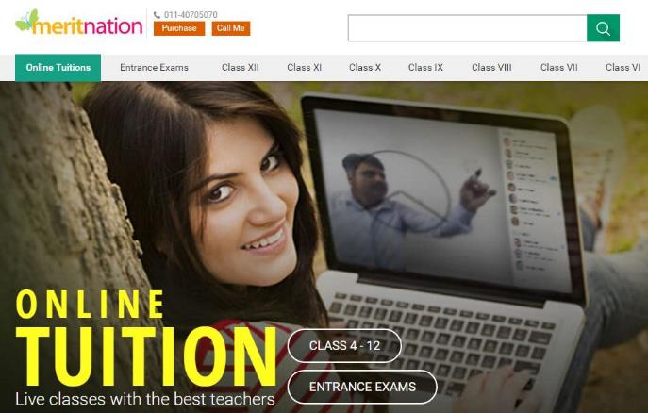

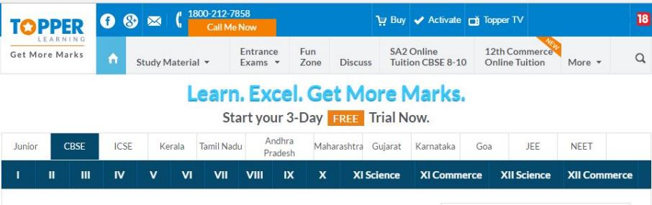

Slide 29


Slide 30




Popular E-commercial Sites

Slide 31
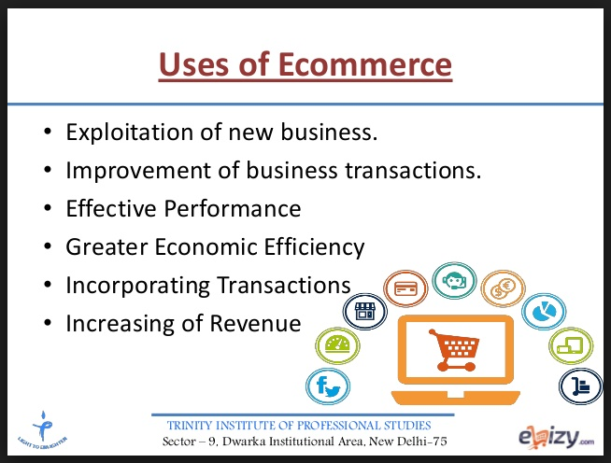

Low Entry Cost
Reduce Transaction Cost
Access to the Global Market
Good Market Share

Slide 32


Slide 33
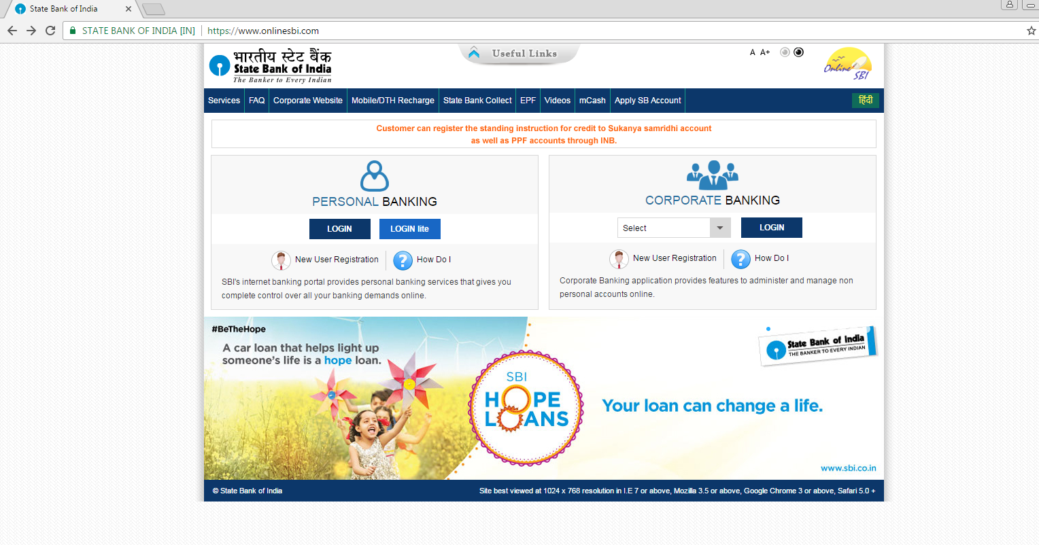
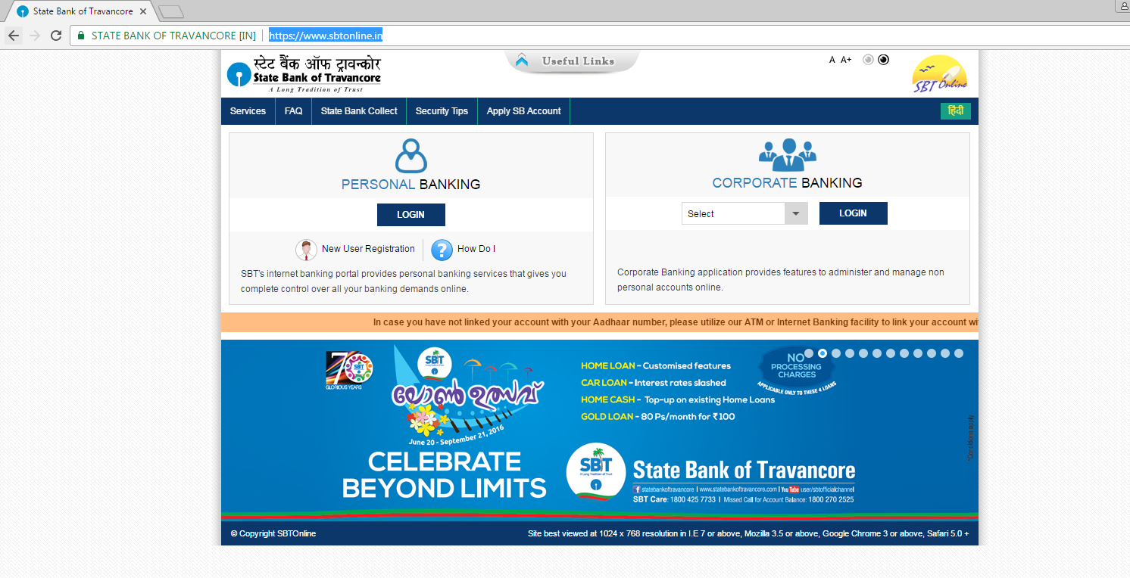
https://www.onlinesbi.com/
https://www.sbtonline.in/

Slide 34
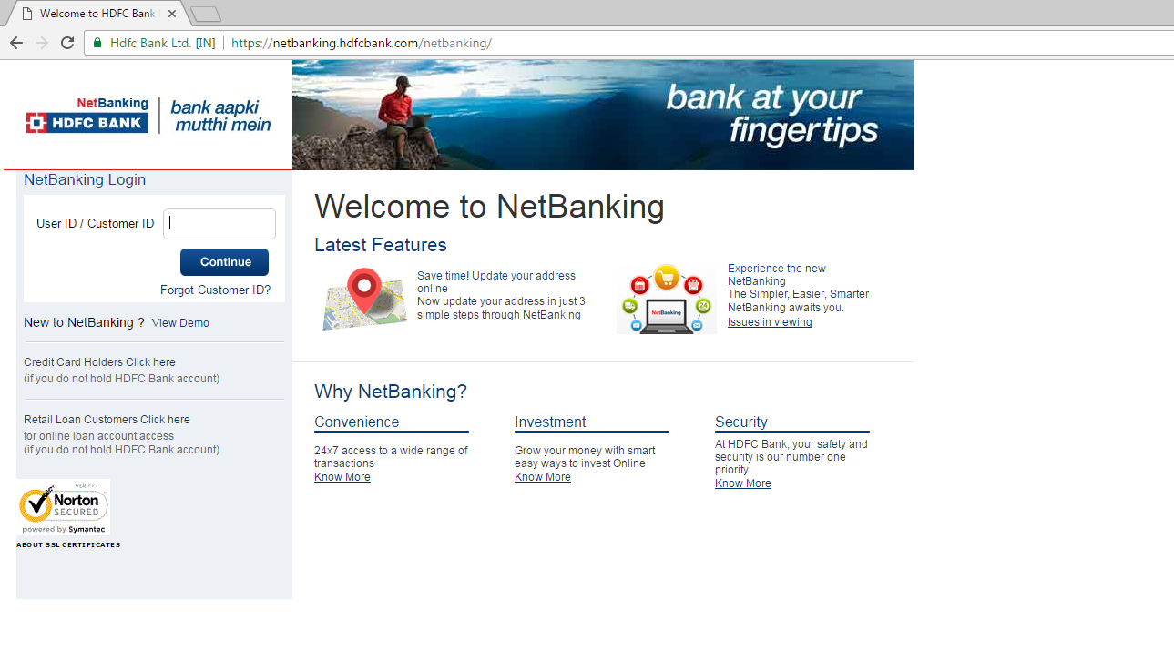
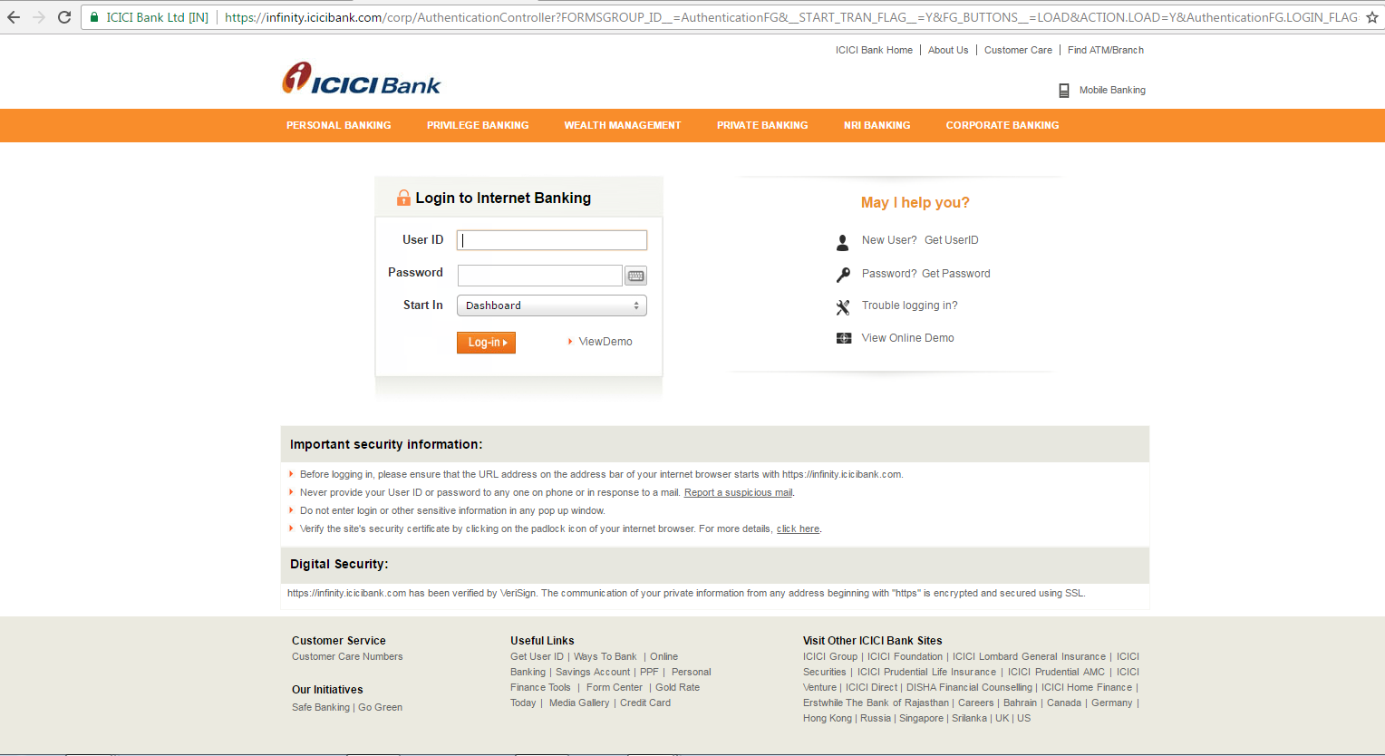
https://netbanking.hdfcbank.com/
https://infinity.icicibank.com/corp/Login.jsp

Slide 35
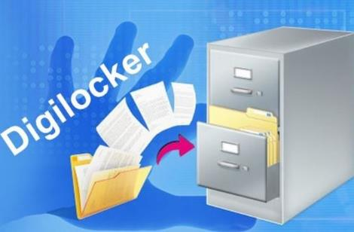

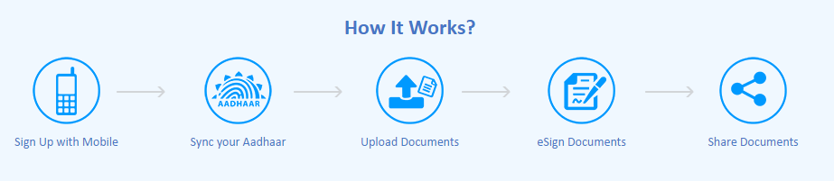
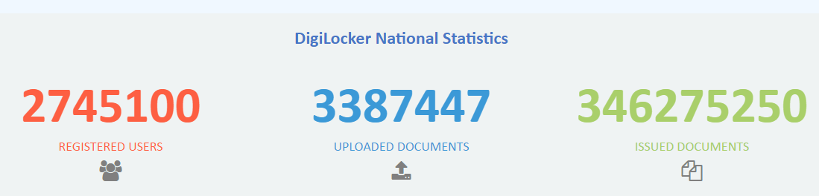
Signing up for DigiLocker is easy - all you need is your mobile number.
Notes:
Digilocker

Slide 36
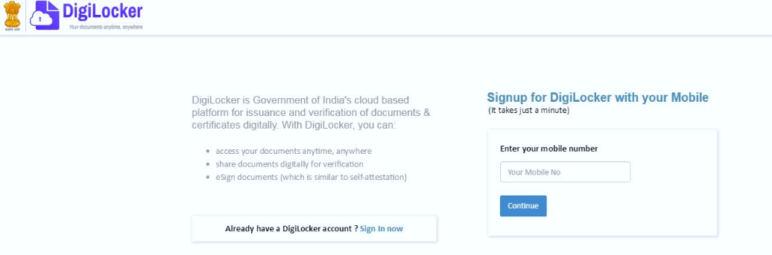
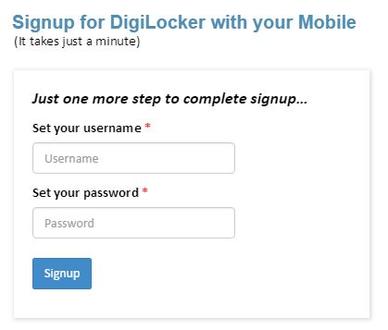
Notes:
Digilocker

Slide 37
DigiLocker can be accessed if you have Aadhaar Card
Registration is possible through Mobile Number
Anytime Anywhere Access
1 GB space is available for cloud storage
Quick turnaround time
Reduce Frauds
self-attestation or digital signature
Corruption Free India
Minimize the use of physical documents
share e-documents online with any registered requester
Secure access to Govt. issued documents
Ensure Authenticity of the e-documents
Well-structured standard document format
download eAadhar
Notes:
Digilocker

Slide 38
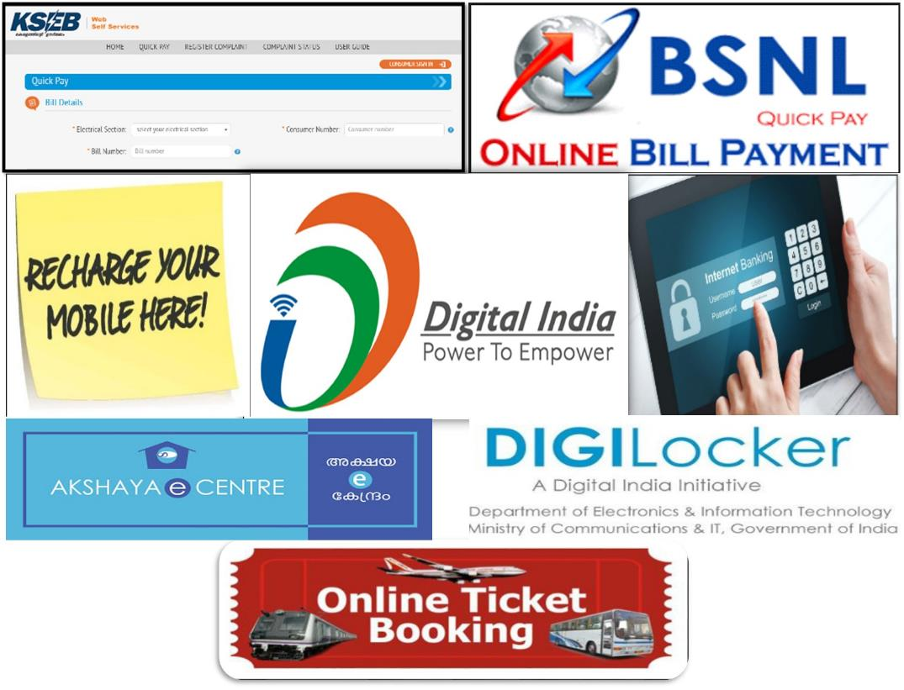


Notes:
The Internet and Consumer Trends

Slide 39
Thank You

